Slide 1
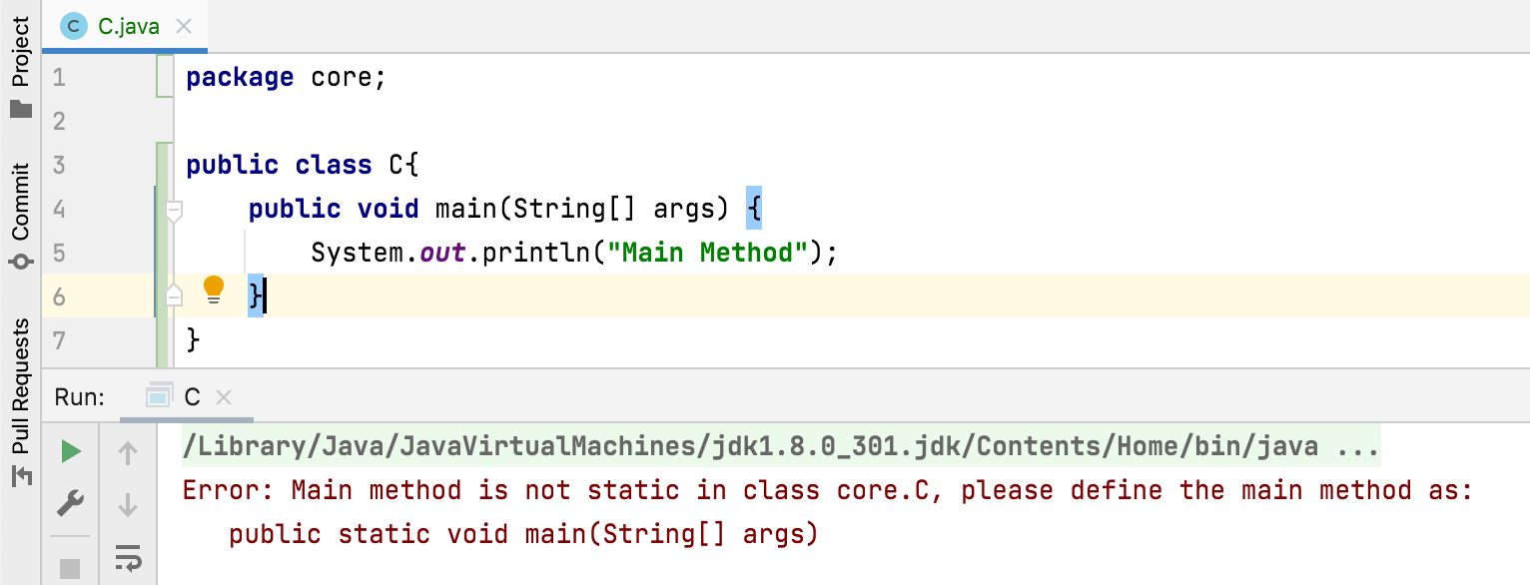
Why main() method must be static? OR Can we declare main() method as non-static?
main() method must be declared as static so that JVM can call main() method without instantiating its class.
Suppose, if main() is allowed to be non-static, then :
To call main method, JVM must instantiate it’s class.
To instantiate it must call constructor of that class.
There will be an ambiguity if constructor of that class takes an argument , then what argument JVM has to pass to instantiate its class.

